Slide 1

IS 352: Emerging Information Technologies and Innovations
Lecture 6.0 & PRACTICALS

Slide 2
Objectives
Supervised Learning : Classification Problems
Naïve Bayes Algorithm

Slide 3

NAÏVE BAYES

Slide 4
Introduction
With time, machine learning algorithms are becoming increasingly complex.
This, in most cases, is increasing performance at the expense of higher training-time requirements.
Fast-training algorithms that deliver decent accuracy are also available.
These types of algorithms are generally based on simple mathematical concepts and principles.

Slide 5
Introduction
Today, we’ll have a look at a similar machine-learning classification algorithm, naive Bayes.
It is an extremely simple, probabilistic classification algorithm which, astonishingly, achieves decent performance in many scenarios.
In machine learning, naive Bayes classifiers are simple, probabilistic classifiers that use Bayes’ Theorem.
Naïve Bayes has strong (naive), independence assumptions between features.
In simple terms, a Naïve Bayes classifier assumes that the presence of a particular feature in a class is unrelated to the presence of any other feature.

Slide 6



Introduction
For example, a ball may be considered a soccer ball if it is hard, round, and about seven inches in diameter.
Even if these features depend on each other or upon the existence of the other features, Naïve Bayes believes that all of these properties independently contribute to the probability that this ball is a soccer ball. This is why it is known as naive.

Slide 7
Introduction
Naive Bayes models are easy to build and are very useful for very large datasets.
Although, naive Bayes models are simple, they are known to outperform even the most highly sophisticated classification models.
They make a good alternative for use in classification problems due to the fact that they require a relatively short training time.

Slide 8

Mathematics Behind Naïve Bayes
Recall, In Conditional Probability:
P(A |B) = $\frac{P(A ∩ B)}{P(B)}……..……….\left(1\right)$
P(B|A) = $\frac{P(B ∩ A)}{P(A)}$ = $\frac{P(A ∩ B)}{P(A)}$ ………(2)
Thus: $P\left(A ∩ B\right)= P(A)$ * $P\left(B\right|A)$ ………….(3)
Substituting (3) into (1) we get: P(A |B) = $\frac{P\left(A\right)∗P(B|A)}{P(B)}$
Bayes Theorem
Notes:
Conditional Probability: The likelihood of an event or outcome occurring, based on the occurrence of a previous event or outcome

Slide 9
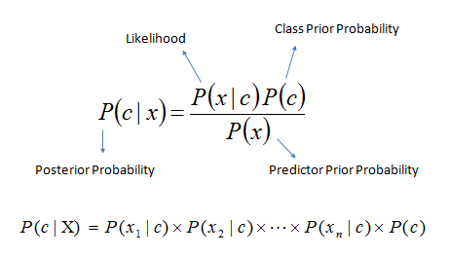
Mathematics Behind Naïve Bayes
Bayes Theorem provides a way of calculating posterior probability P(c|x) from P(c), P(x), and P(x|c).
Consider the following equation:
P(c|x): posterior probability of class(c, target) given predictor(x, attributes). This represents the probability of c being true, provided x is true.
P(c): is the prior probability of class. This is the observed probability of class out of all the observations.
P(x|c): is the likelihood which is the probability of predictor-given class. This represents the probability of x being true, provided c is true.
P(x): is the prior probability of the predictor. This is the observed probability of predictor out of all the observations.

Slide 10
Mathematics Behind Naïve Bayes
Bayes Theorem provides a way of calculating posterior probability P(c|x) from P(c), P(x), and P(x|c).
Consider the following equation:
P(c|x): posterior probability of class(c, target) given predictor(x, attributes). This represents the probability of c being true, provided x is true.
P(c): is the prior probability of class. This is the observed probability of class out of all the observations.
P(x|c): is the likelihood which is the probability of predictor-given class. This represents the probability of x being true, provided c is true.
P(x): is the prior probability of the predictor. This is the observed probability of predictor out of all the observations.

Slide 11
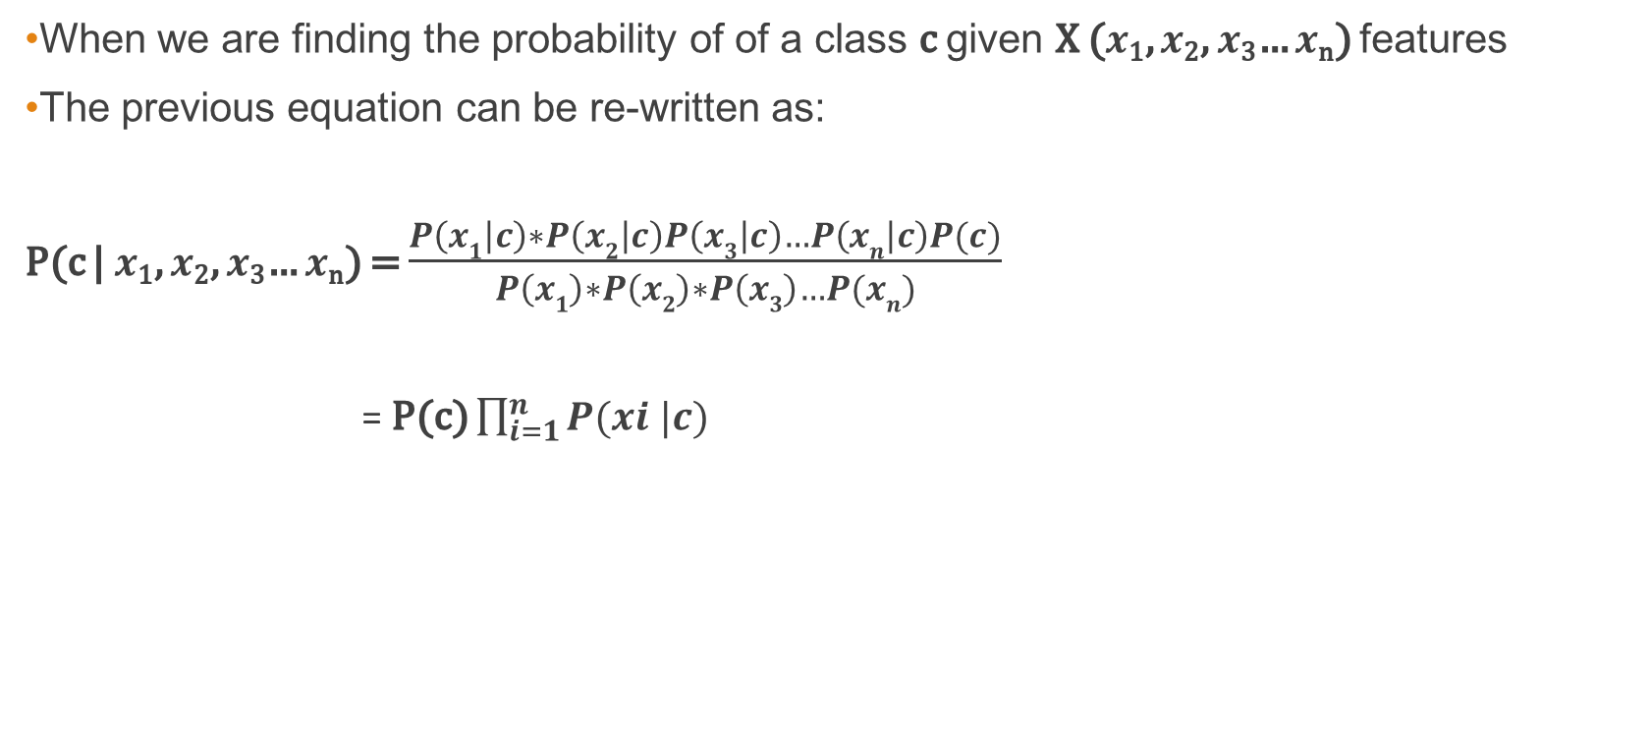
Mathematics Behind Naïve Bayes
When we are finding the probability of of a class c given X ($x$₁, $x$₂, $x$₃… $x$_{n}) features
The previous equation can be re-written as:
P(c | $x$₁, $x$₂, $x$₃… $x$_{n}) = $\frac{P\left(x1 | c\right)∗P\left(x2 | c\right)P\left(x3 | c\right)…P\left(xn | c\right)P(c)}{P\left(x1\right)∗P\left(x2\right)∗P\left(x3\right)…P(xn)}$
= P(c) $\prod_{i=1}^{n}{P(xi |c)}$

Slide 12
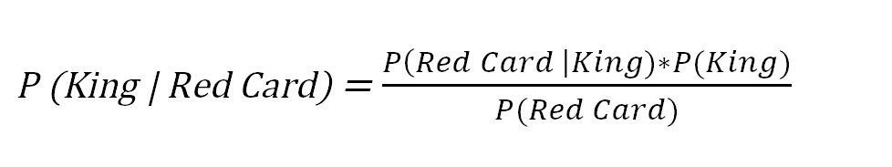
Mathematics Behind Naïve Bayes
Let’s better understand this with the help of a simple example.
Consider a well-shuffled deck of playing cards. A card is picked from that deck at random.
The objective is to find the probability of a King card, given that the card picked is red in color.
i.e. P(King | Red Card) = ?

Slide 13
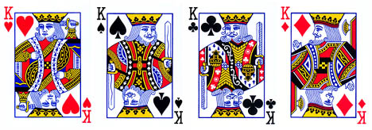
Mathematics Behind Naïve Bayes
There are 52 cards in a standard deck in which 4 are kings and 26 are red.

Slide 14
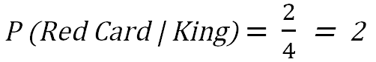
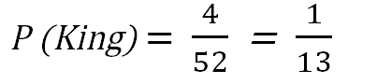

Mathematics Behind Naïve Bayes
Thus,
P (Red Card | King) → Probability of getting a Red card given that the card chosen is King
P (King) →Probability that the chosen card is a King
P(Red Card) → Probability that the chosen card is red

Slide 15
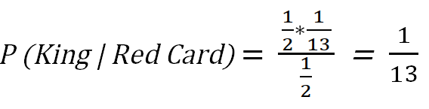
Mathematics Behind Naive Bayes
Therefore:

Slide 16
Understanding Naïve Bayes
Consider the following example in which we are required to predict the weather based on three predictors: humidity, temperature and wind speed.
The training data is as shown on the RHS:
Can you use Naïve Bayes to predict the weather for the following test observation
Humidity | Temperature | Wind Speed | Weather
Humid | Hot | Fast | Sunny
Humid | Hot | Fast | Sunny
Humid | Hot | Slow | Sunny
Not Humid | Cold | Fast | Sunny
Not Humid | Hot | Slow | Rainy
Not Humid | Cold | Fast | Rainy
Humid | Hot | Slow | Rainy
Humid | Cold | Slow | Rainy
Humidity | Temperature | Wind Speed
Humid | Cold | Fast

Slide 17
Understanding Naïve Bayes
We have to determine which posterior is greater sunny or rainy.
The posterior probability can be calculated by first, constructing a frequency table for each attribute against the target.
Transforming the frequency tables to likelihood tables
Finally use the Naïve Bayesian equation to calculate the posterior probability for each class.
The class with the highest posterior probability is the outcome of prediction.

Slide 18
Understanding Naïve Bayes
Humidity | Weather = Sunny | Weather = Rainy
Humid | 3 | 2 | 5
Not Humid | 1 | 2 | 3
 | 4 | 4 | 8
Temperature | Weather = Sunny | Weather = Rainy
Hot | 3 | 2 | 5
Cold | 1 | 2 | 3
 | 4 | 4 | 8
Wind Speed | Weather = Sunny | Weather = Rainy
Fast | 3 | 1 | 4
Slow | 1 | 3 | 4
 | 4 | 4 | 8

Slide 19
Understanding Naïve Bayes
Humidity | Weather = Sunny | Weather = Rainy
Humid | 3/4 | 2/4 | 5/8
Not Humid | 1/4 | 2/4 | 3/8
 | 4/8 | 4/8
Temperature | Weather = Sunny | Weather = Rainy
Hot | 3/4 | 2/4 | 5/8
Cold | 1/4 | 2/4 | 3/8
 | 4/8 | 4/8
Wind Speed | Weather = Sunny | Weather = Rainy
Fast | 3/4 | 1/4 | 4/8
Slow | 1/4 | 3/4 | 4/8
 | 4/8 | 4/8

Slide 20
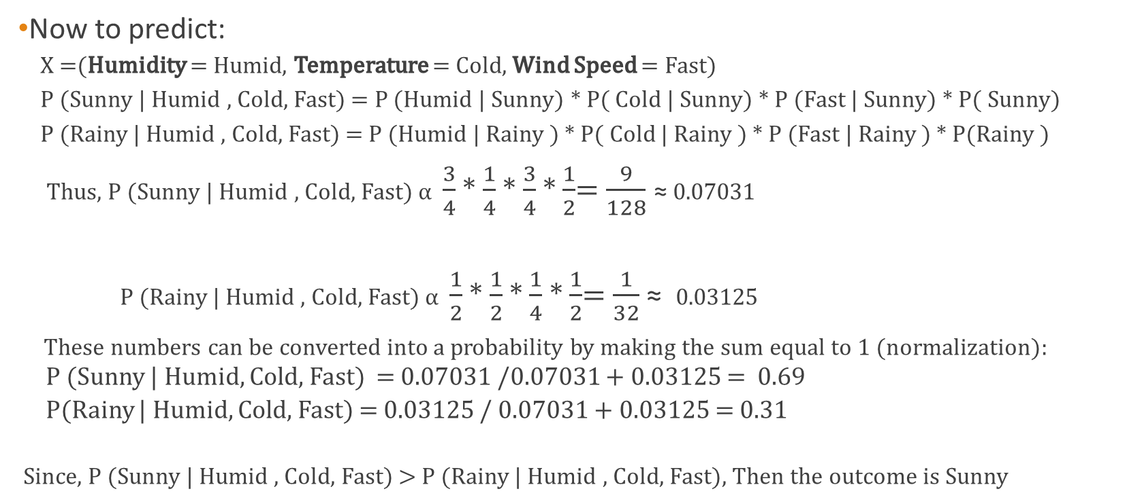
Understanding Naïve Bayes
Now to predict:
X =(Humidity = Humid, Temperature = Cold, Wind Speed = Fast)
P (Sunny | Humid , Cold, Fast) = P (Humid | Sunny) * P( Cold | Sunny) * P (Fast | Sunny) * P( Sunny)
P (Rainy | Humid , Cold, Fast) = P (Humid | Rainy ) * P( Cold | Rainy ) * P (Fast | Rainy ) * P(Rainy )
Thus, P (Sunny | Humid , Cold, Fast) α $\frac{3}{4}$ * $\frac{1}{4}$* $\frac{3}{4}$ * $\frac{1}{2}$= $\frac{9}{128}$ ≈ 0.07031
P (Rainy | Humid , Cold, Fast) α $\frac{1}{2}$ * $\frac{1}{2}$* $\frac{1}{4}$ * $\frac{1}{2}$= $\frac{1}{32}$ ≈ 0.03125
These numbers can be converted into a probability by making the sum equal to 1 (normalization):
P (Sunny | Humid, Cold, Fast) = 0.07031 /0.07031 + 0.03125 = 0.69
P(Rainy | Humid, Cold, Fast) = 0.03125 / 0.07031 + 0.03125 = 0.31
Since, P (Sunny | Humid , Cold, Fast) > P (Rainy | Humid , Cold, Fast), Then the outcome is Sunny

Slide 21
Applications of Naïve Bayes
Recommendation System: Naive Bayes classifiers are used in various inference systems for making certain recommendations to users out of a list of possible options.
Real-Time Prediction: Naive Bayes is a fast algorithm, which makes it an ideal fit for making predictions in real time.
Multiclass Prediction: This algorithm is also well-known for its multiclass prediction feature. Here, we can predict the probability of multiple classes of the target variable.
Sentiment Analysis: Naive Bayes is used in sentiment analysis on social networking datasets like X* and Facebook* to identify positive and negative customer sentiments.
Text Classification: Naive Bayes classifiers are frequently used in text classification and provide a high success rate, as compared to other algorithms.
Spam Filtering: Naive Bayes is widely used in spam filtering for identifying spam email.

Slide 22
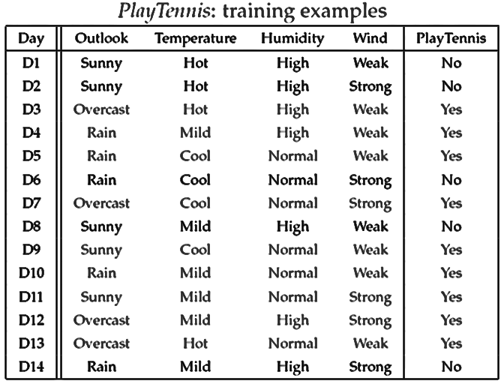
TASK
Consider the dataset below for a Naïve Bayes classifier used to determine whether a tennis game should be played or postponed and answer the questions that follow:
Predict the outcome for the following:
x = (Outlook=Sunny, Temperature=Cool, Humidity=High, Wind=Strong)
x = (Outlook=Overcast, Temperature=Cool, Humidity=High, Wind=Strong)

Slide 23
TASK
Read more on Laplace Smoothing and explain it to your colleague. What problem does it solve ? Use examples for your discussion.

Slide 24
END

